Slide 1
Power flow calculation on IEEE 14-bus system
Yaze Li
yazeli@email.uark.edu

Slide 2
OUTLINE
Introduction
Basics of AC circuit analysis
Per-unit presentation
Power Flow
Motivation
Bus Admittance Matrix
Classic Formulation
Newton-Raphson Method
Introduction
Solve Power Flow
Simulation

Slide 3
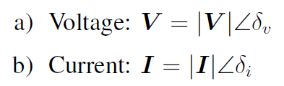
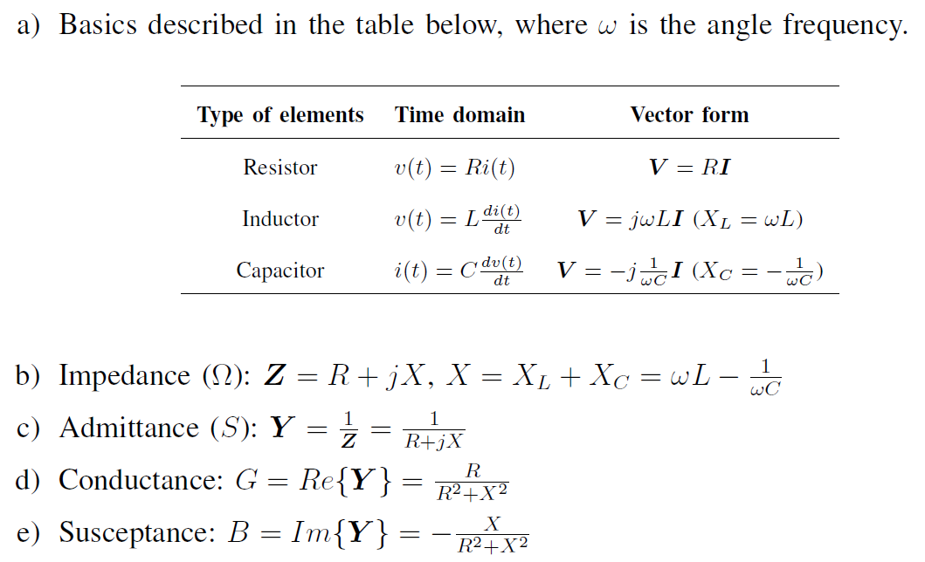
INTRODUCTION
Basics of AC circuit analysis
Single phase in vector form:
Volt-ampere characteristics:

Slide 4
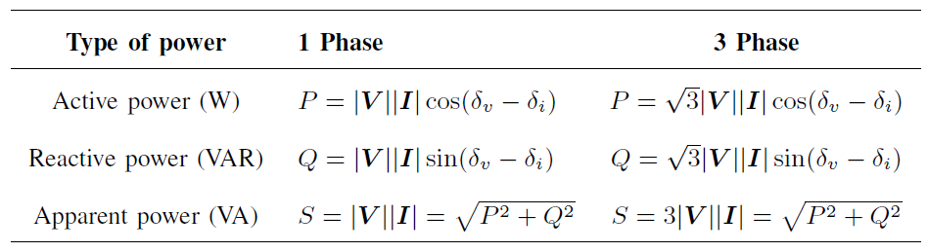

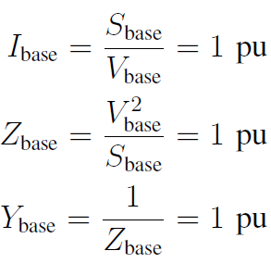
INTRODUCTION
Basics of AC circuit analysis (Cont’d)
Power analysis:
Per-unit presentation
Independent base values:
Rest of the units:

Slide 5
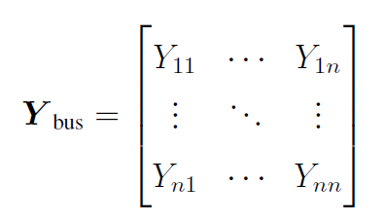

POWER FLOW
Motivation
Power flow studies are employed by transmission and utility companies and are of extreme importance in transmission expansion planning (TEP), operation, and control.
Bus Admittance Matrix
The element:
With given voltage of the buses, the current:

Slide 6
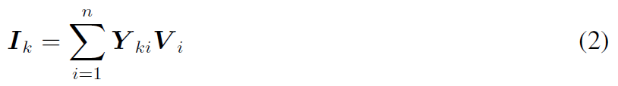
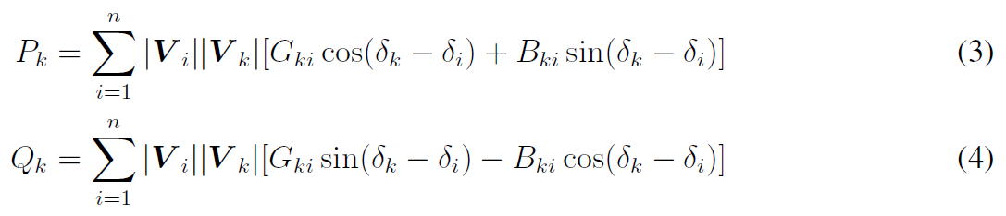
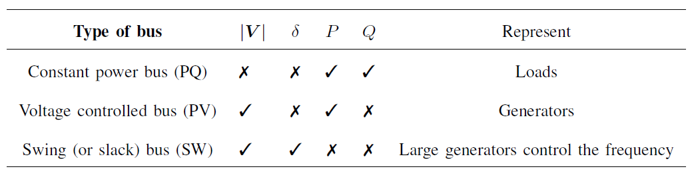
POWER FLOW
Bus Admittance (Cont’d)
Apply Kirchhoff’s current law :
The bus power injections equations:
Classical Formulation

Slide 7
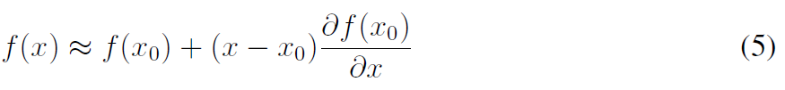


NEWTON-RAPHSON METHOD
Introduction
Taylor series linear approximation:
Approximate x:
Newton-Raphson equation:
Root approximation: 1-dim: n-dim:

Slide 8
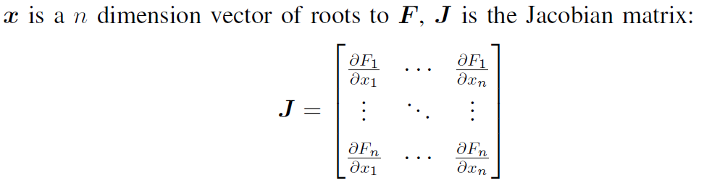
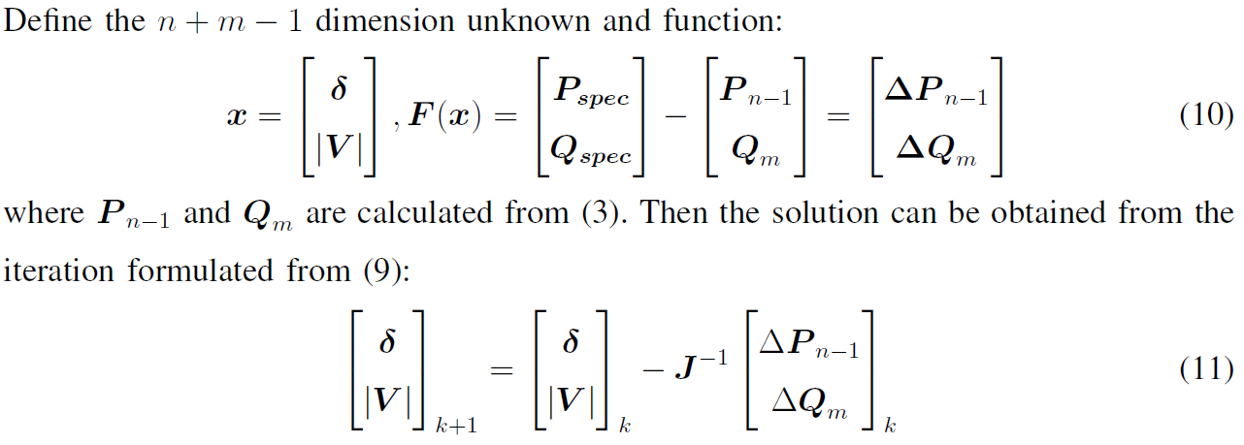
NEWTON-RAPHSON METHOD
Introduction (Cont’d)
Solve Power Flow

Slide 9

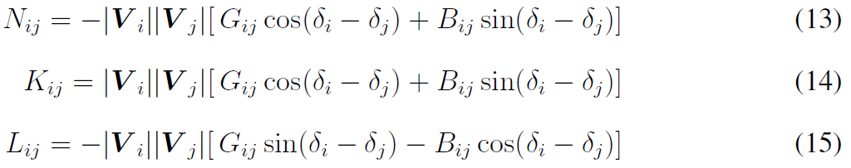
NEWTON-RAPHSON METHOD
Solve Power Flow (Cont’d)
Calculate the Jacobian matrix
Off-diagonal element：

Slide 10
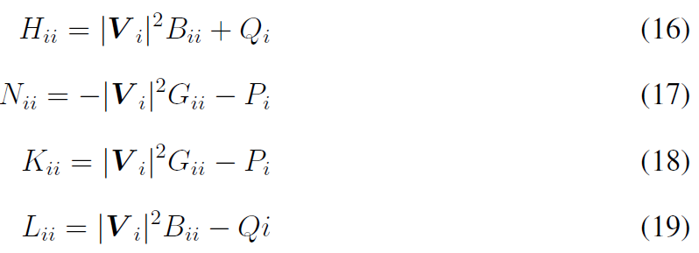
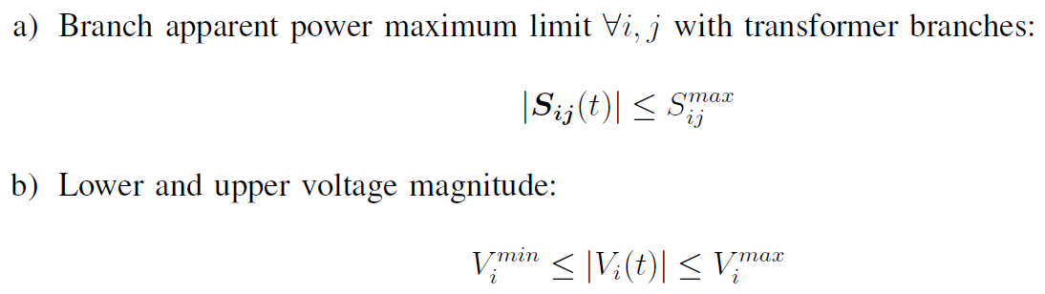
NEWTON-RAPHSON METHOD
Calculate the Jacobian matrix (Cont’d)
Diagonal element：
Common power flow constraint:

Slide 11
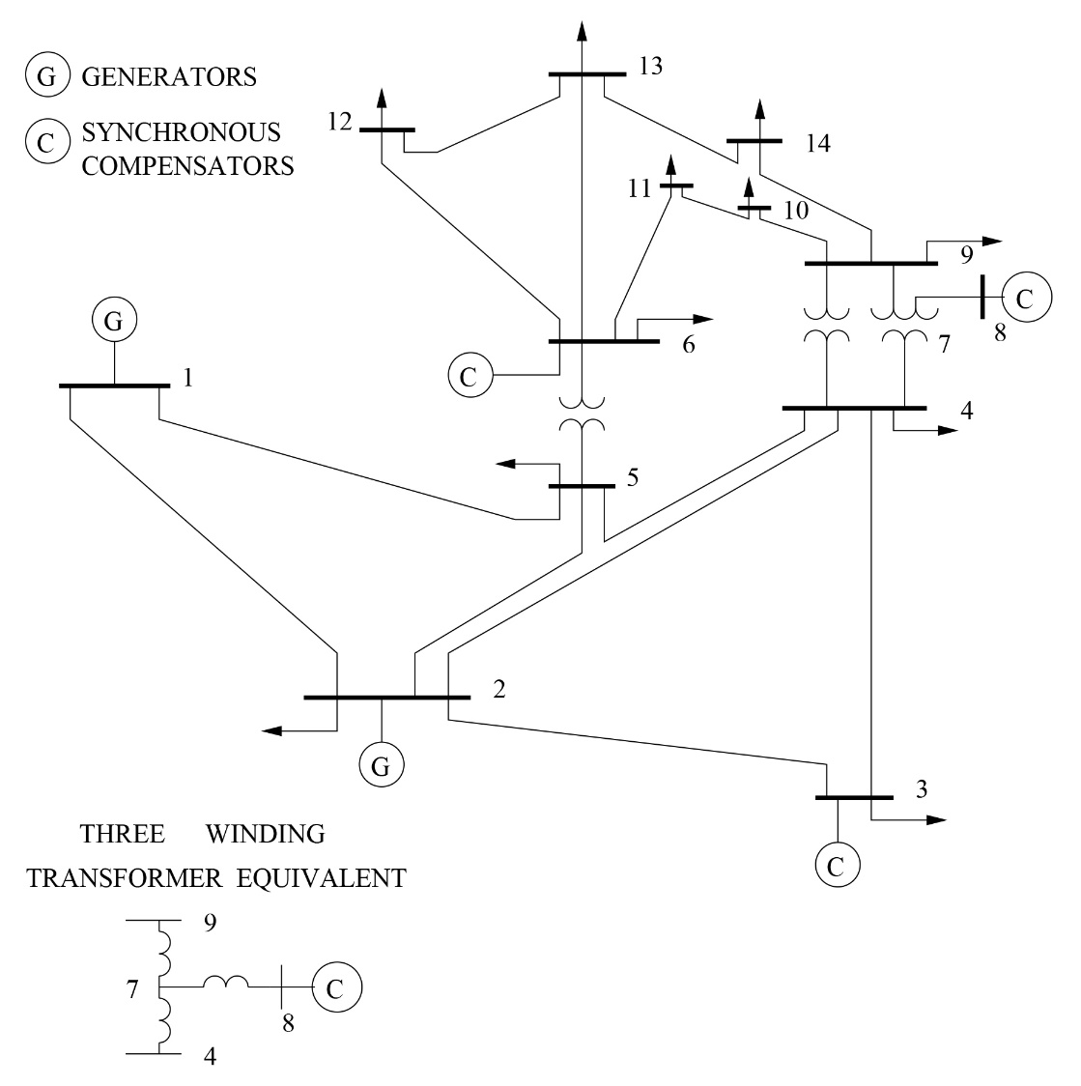
NEWTON-RAPHSON METHOD
IEEE 14-bus system
The IEEE 14 Bus test system is a very simple representation of the American power grid as of 1962.
The classic test case consists of 5 generators, 11 loads, and 14 buses. Base power: 100VA
Base voltage: 110V
Operating frequency: 60 Hz, corresponding to a radian frequency, ω, of 377.

Slide 12
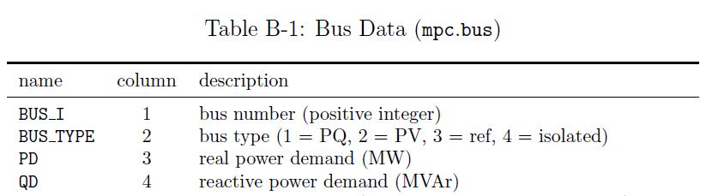
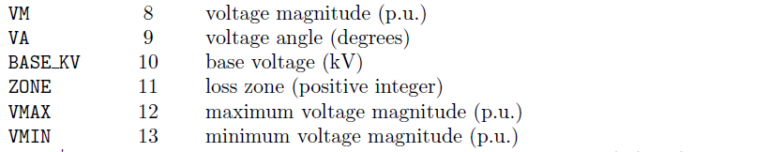
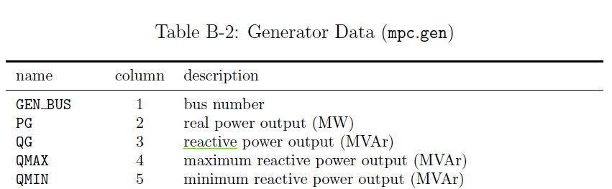
SIMULATION
Part of notations of system parameters in MATPOWER

Slide 13
SIMULATION
Result (5 iterations) compared with MATPOWER
Voltage magnitude:

Slide 14
SIMULATION
Result (5 iterations) compared with MATPOWER
Voltage angle:

